Slide 1
CLIP DE VIDEO CON AUDIO
Here is where your presentation begins

Slide 2

AfterEfects

Slide 3

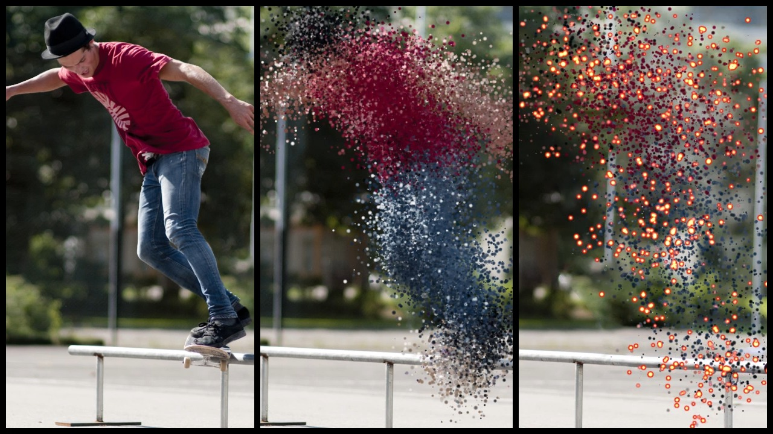
Trap Code Effects

Slide 4
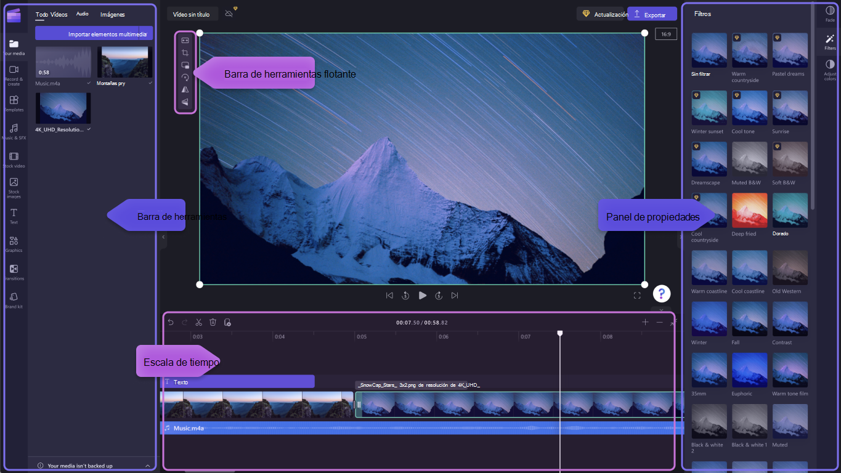


Clipcharm y Pexels

Slide 5

ASEPRITE

Slide 6
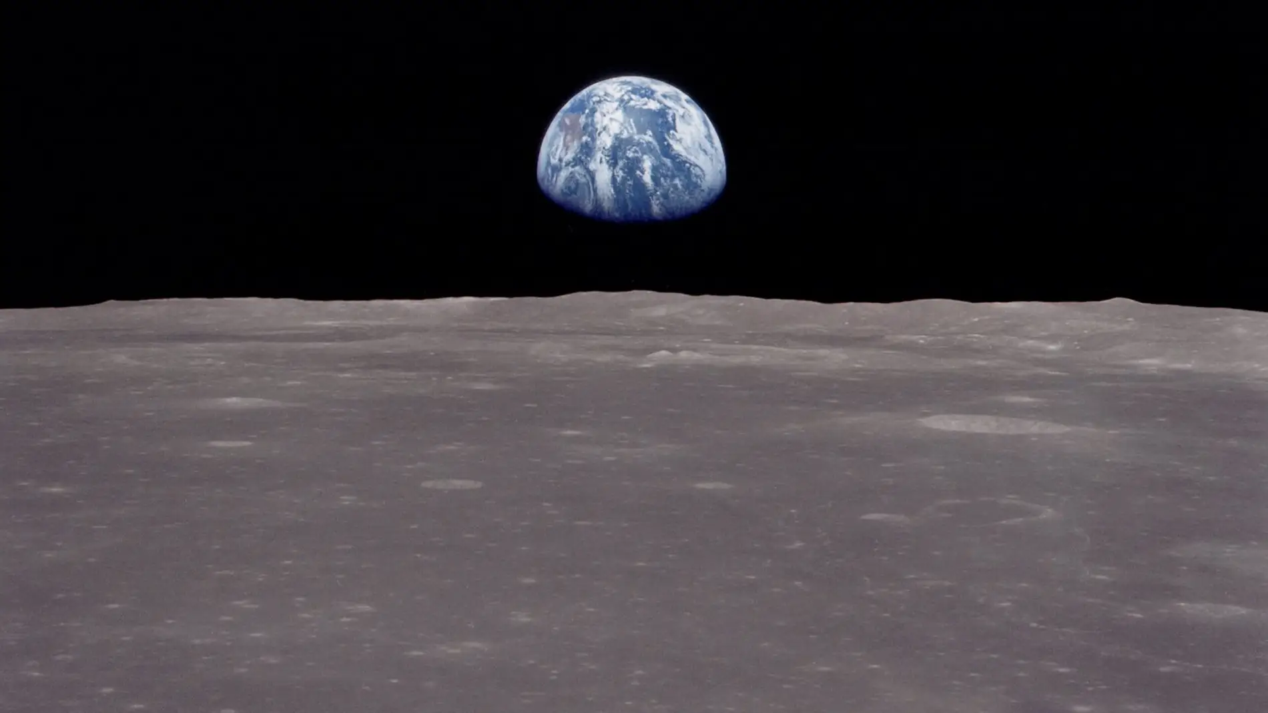


Slide 7
GRACIAS

